Slide 1
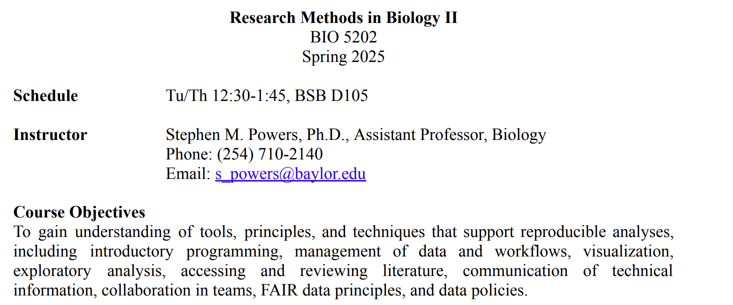

Slide 2
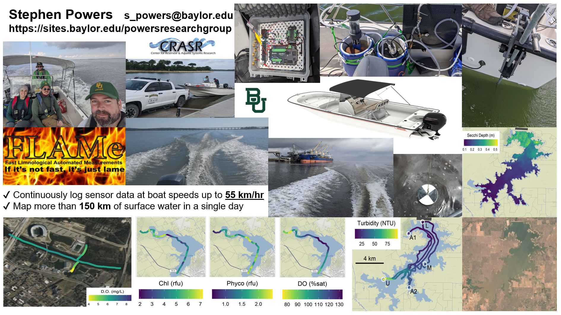

Slide 3
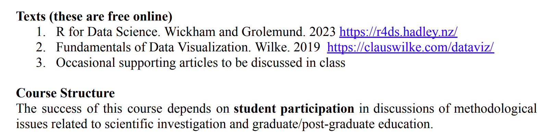

Slide 4
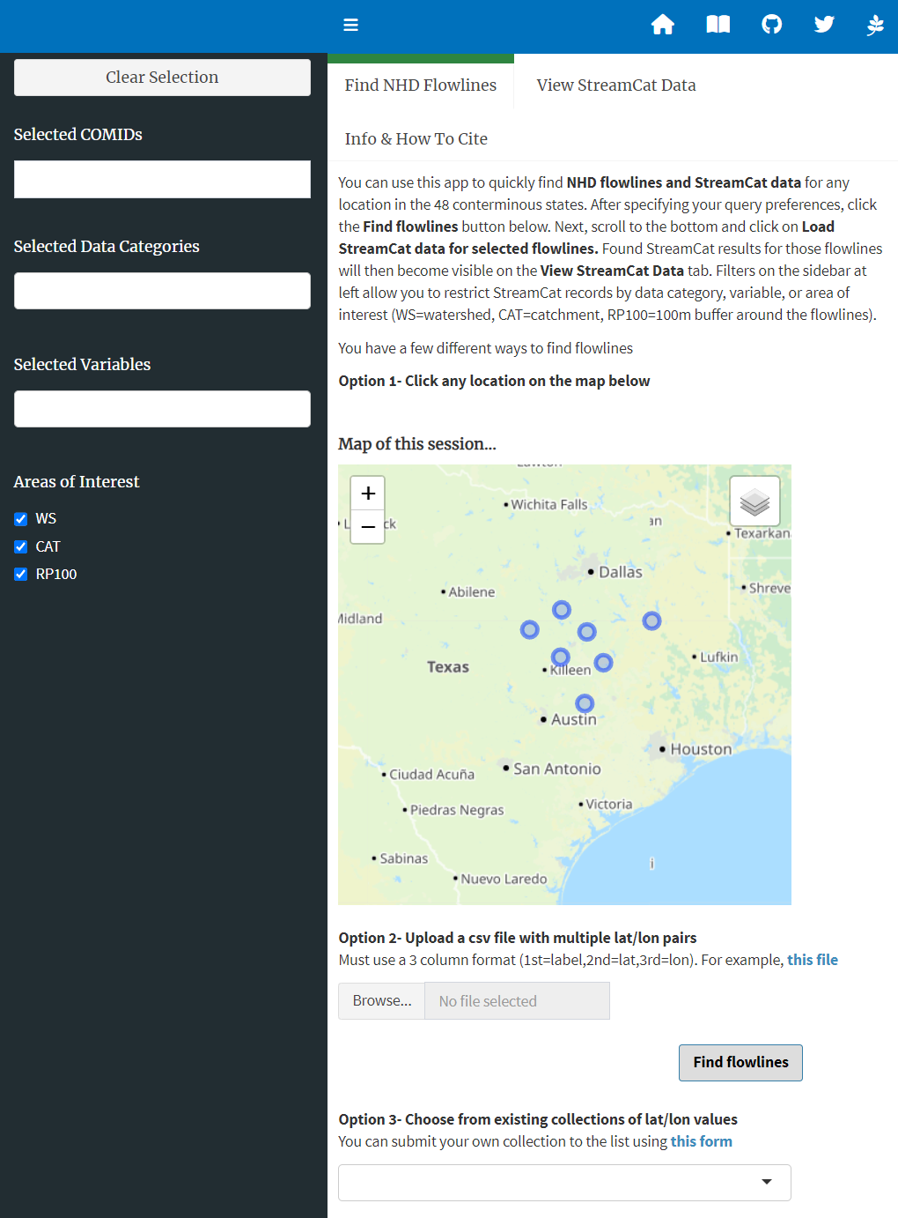
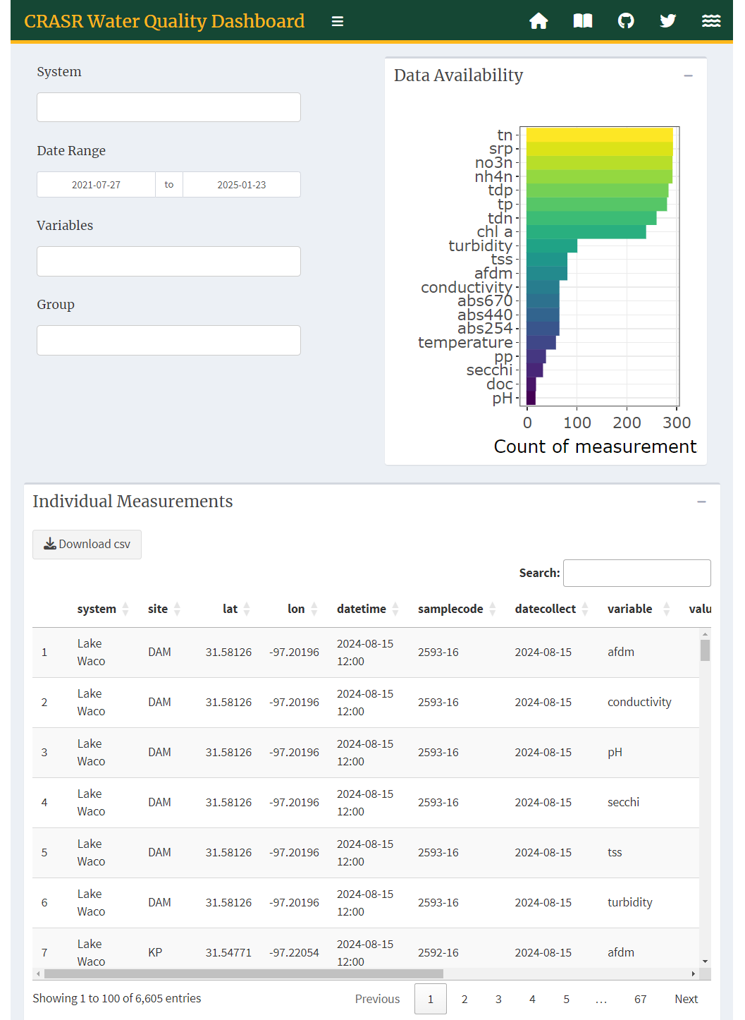
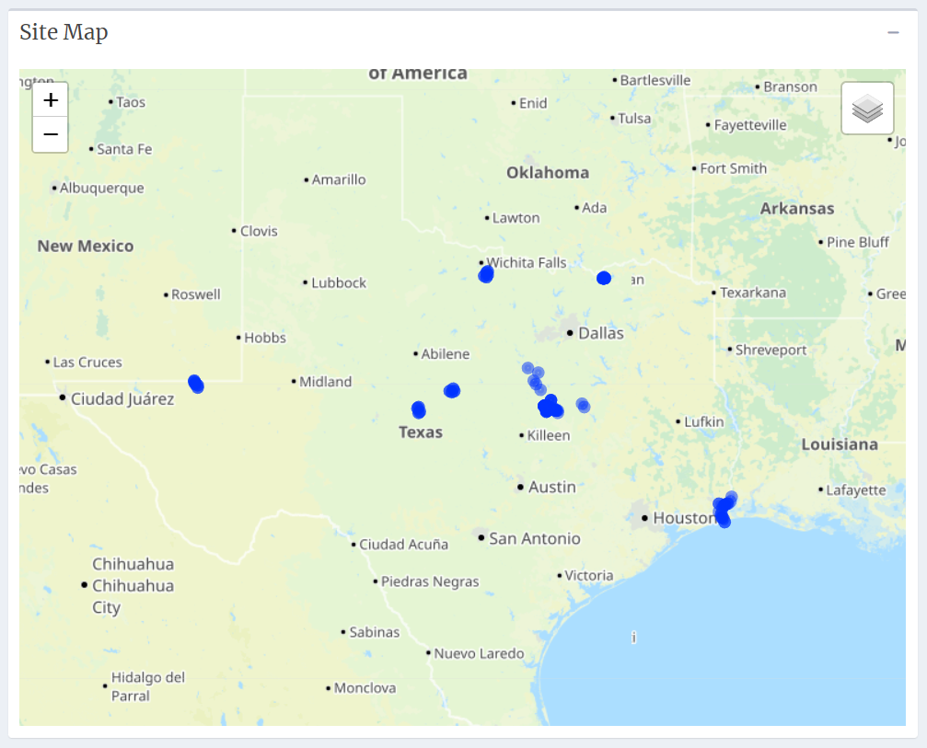
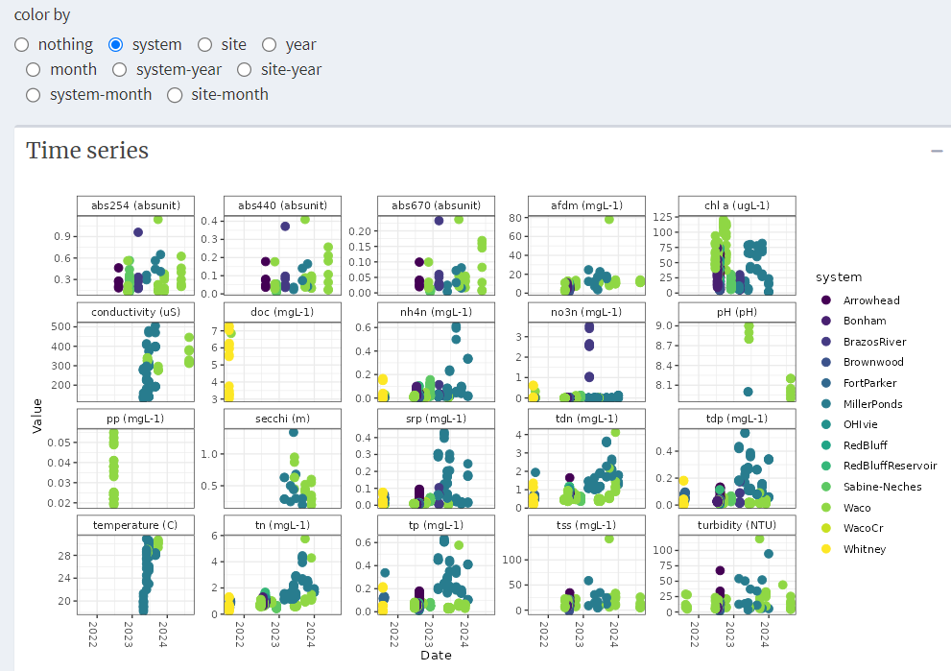
R-powered Data Dashboards
https://waterfolk.shinyapps.io/streamcat
https://waterfolk.shinyapps.io/CRASRwaterquality

Slide 5
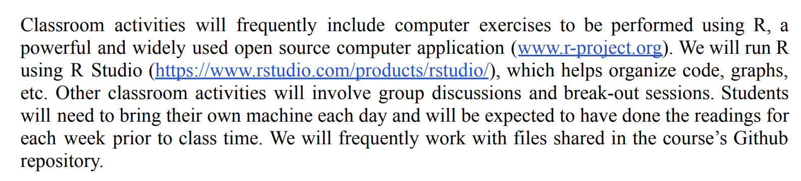

Slide 6
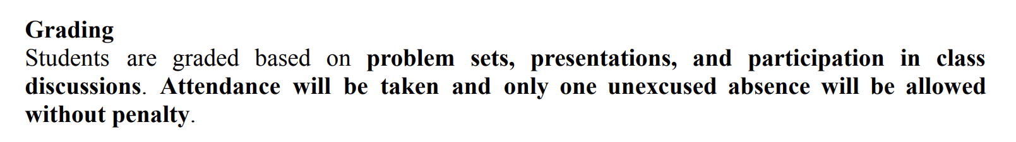

Slide 7
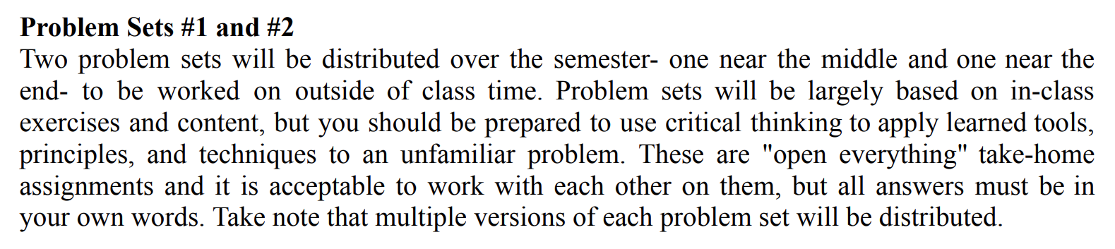

Slide 8
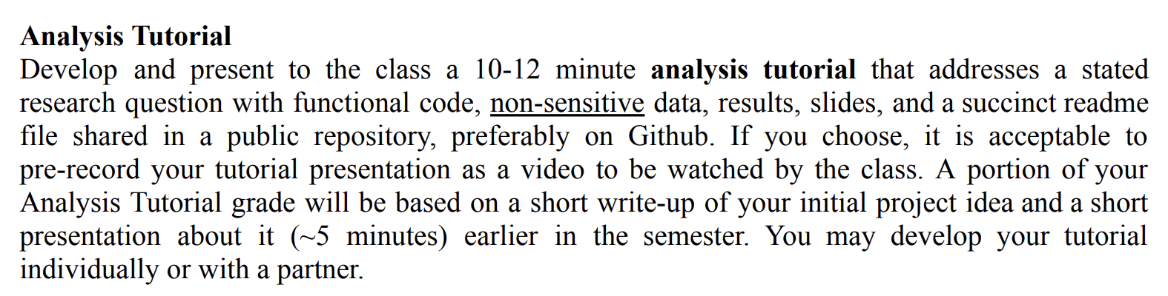

Slide 9
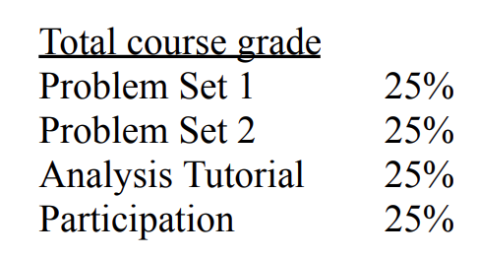

Slide 10
Introductions

Slide 11
Survey

Slide 12
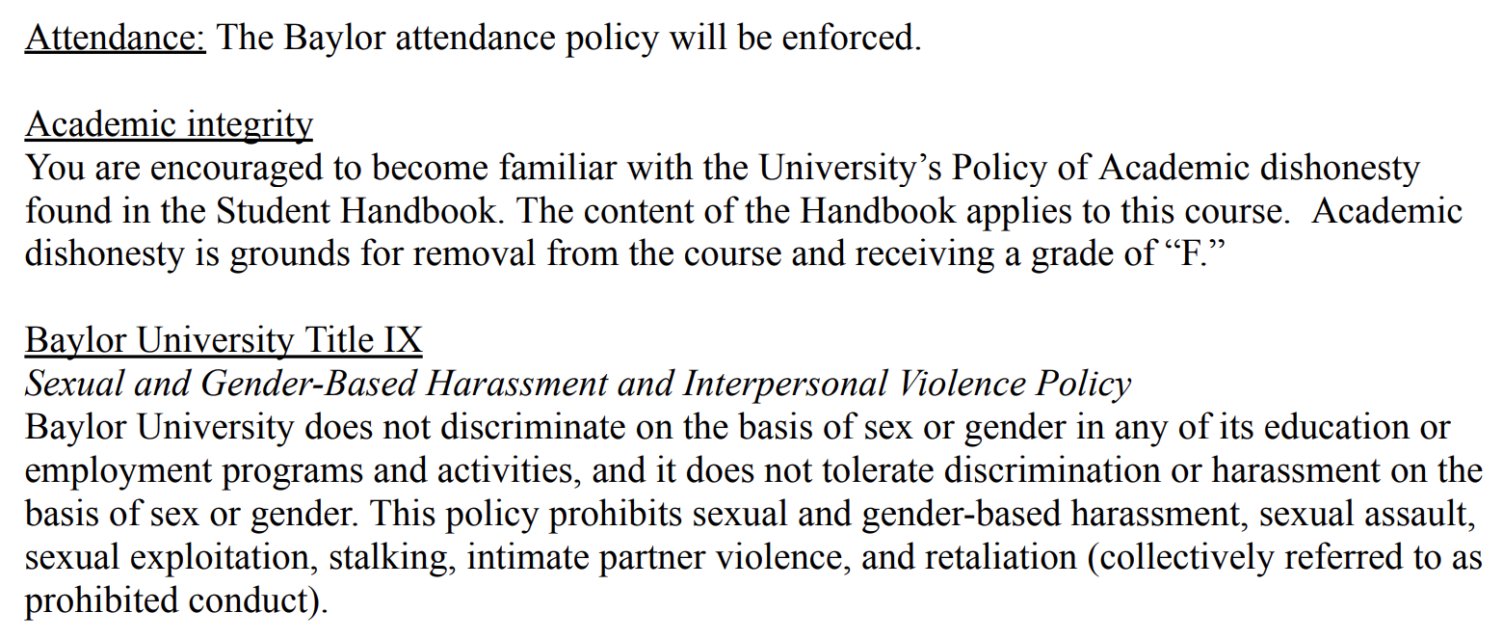

Slide 13
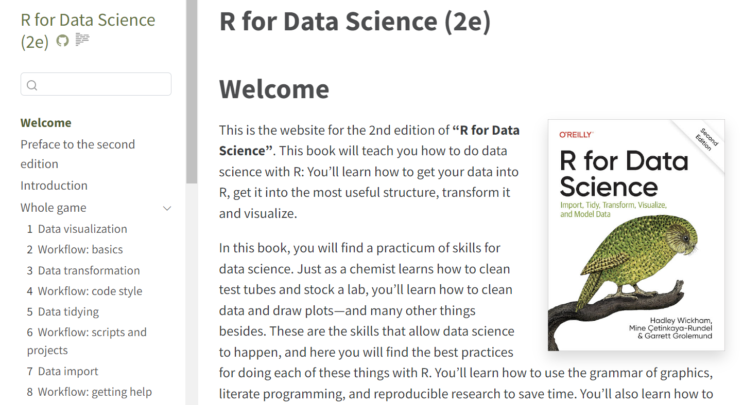
For next week
Read Introduction of Wickham and Grolemund

Slide 15
Agenda
-Navigating Wickham & Grolemund
-Setting up your machine to run R code
-Accessing files on Github
-Basic R syntax
-R packages, package installation
-R cheat sheets
-Coding Exercises in Rstudio
-Logistics

Slide 16
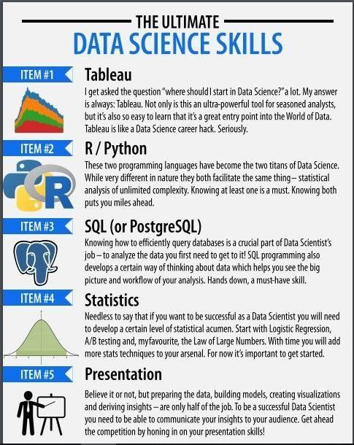
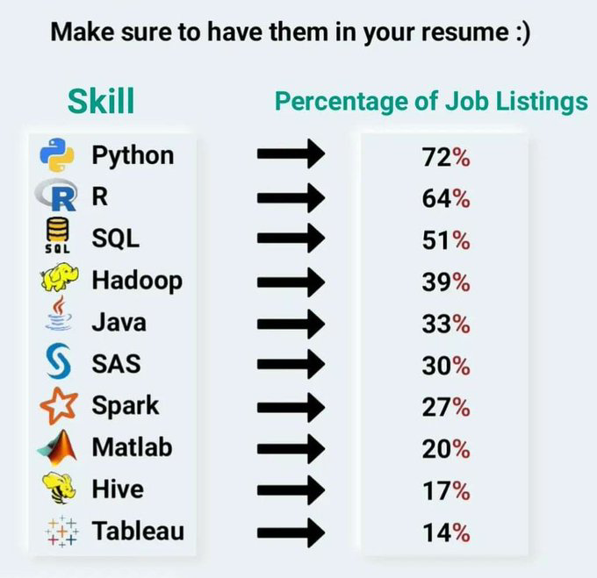
10 most common Data Science skills in jobs

Slide 17
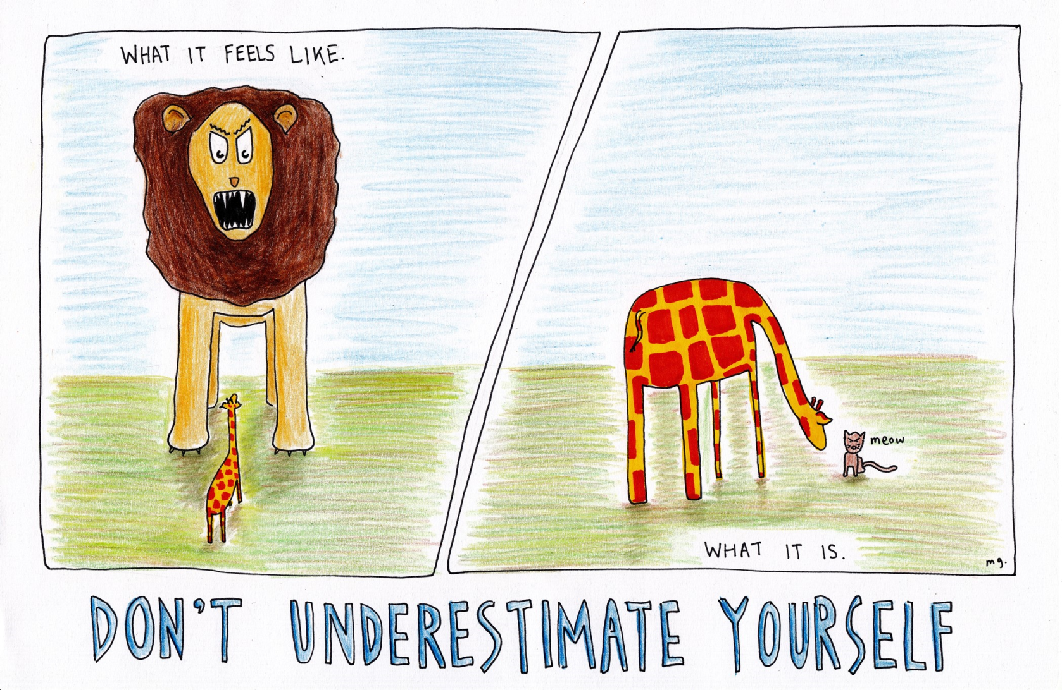
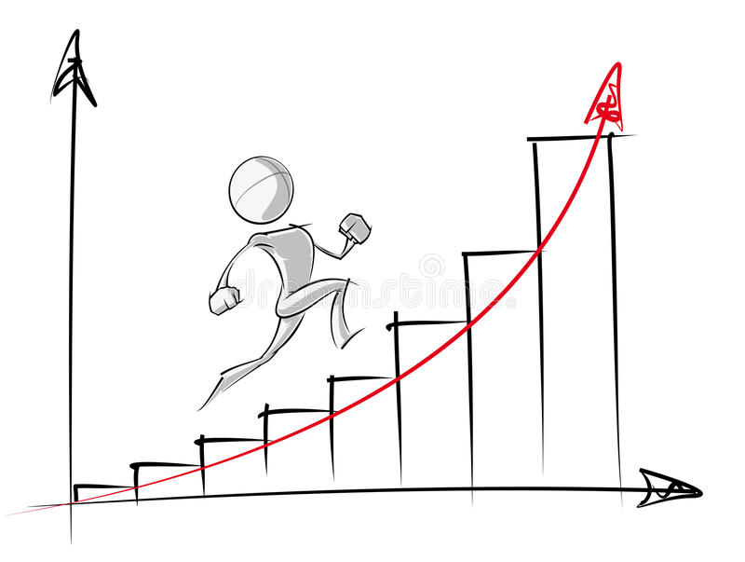
The most important lesson I will attempt to communicate in coming weeks…
Do not underestimate your ability to learn programming. You can do it.

Slide 18
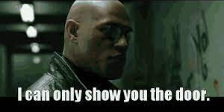
The second most important lesson I will attempt to communicate in coming weeks…
Do not expect your instructor or this course to gift you programming skills. You will need to go for it, and learn to teach yourself (beyond this course, and semester).

Slide 19


The third most important lesson I will attempt to communicate in coming weeks…
my_variable <- 10
my_varıable
#> Error in eval(expr, envir, enclos): object 'my_varıable' not found
Coding is really frustrating at first. It becomes a happier place over time. Be patient as you train your eyes and brain to inspect code extremely closely (Where's Waldo?).

Slide 20
Experience

Slide 21
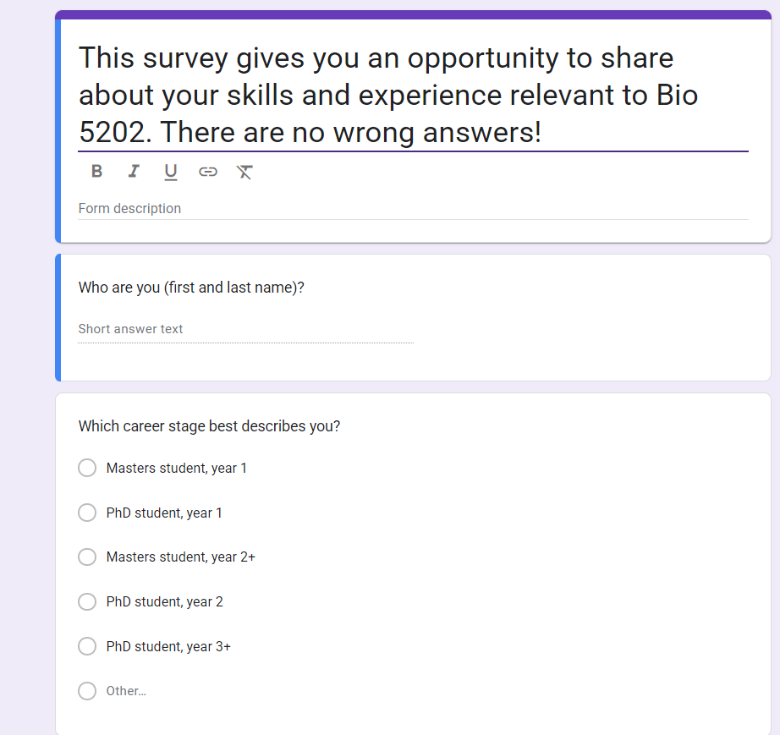
Check all the boxes that describe your experience with the R/Rstudio platform
Haven't used yet, or seldom used yet
16
Used in prior/current research or coursework
9
Moderate- have used in most months over past year
1

Slide 22
How long have you used Github?
0 years 23
0.5 years 1
1 year 1
2 years 1

Slide 23
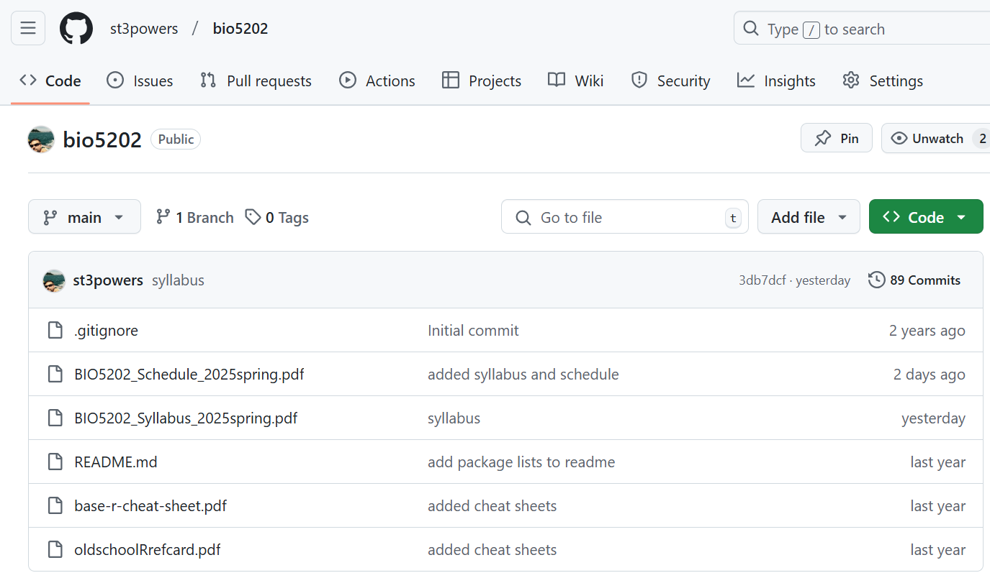


Slide 24
Get set up!

Slide 25
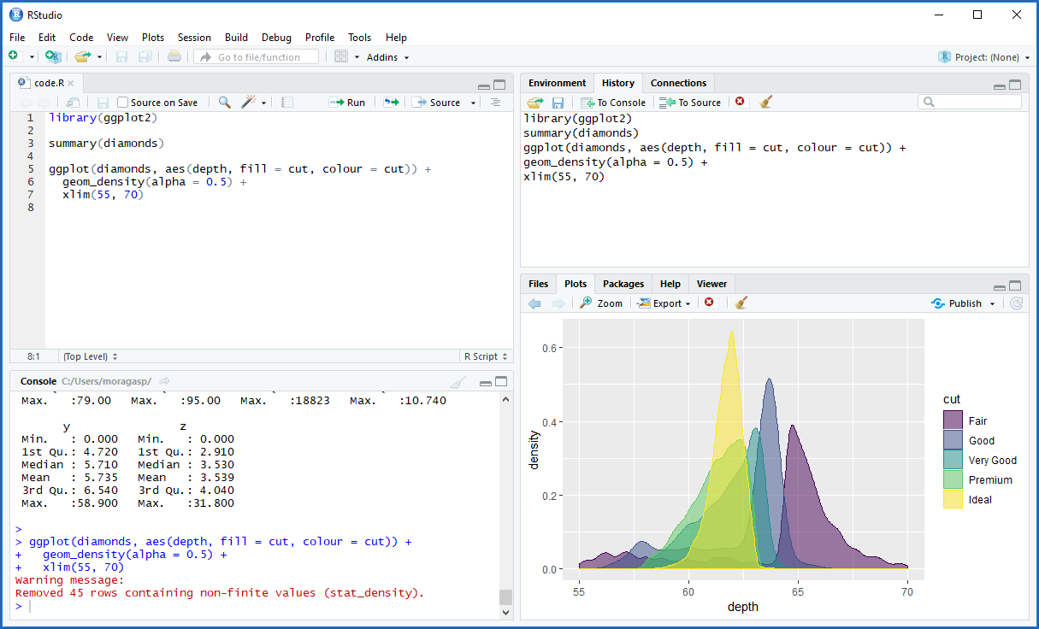
Workspace & History
Code Editor
Viewer
Console

Slide 26
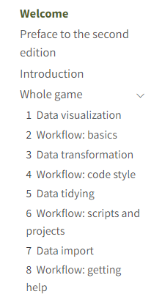
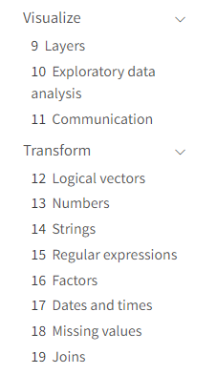
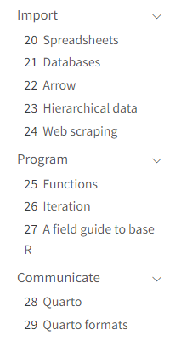
Read
1- Data visualization
2- Workflow: basics

Slide 28
https://r4ds.hadley.nz/

Slide 30
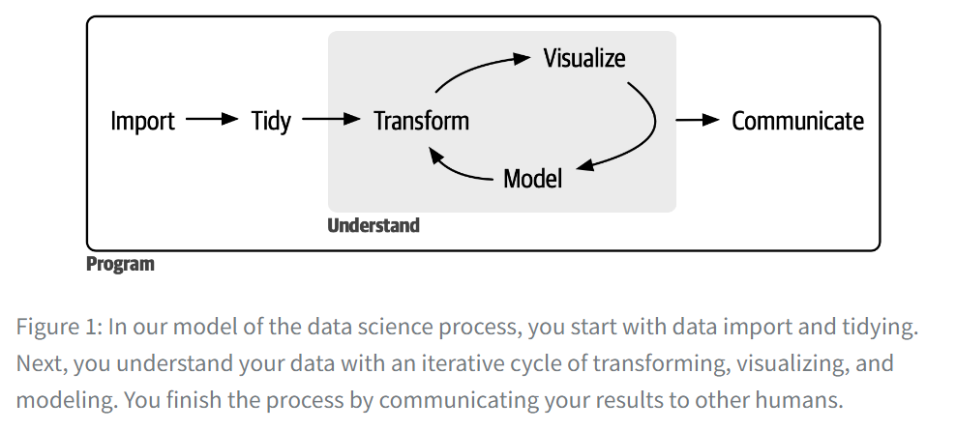
Tidy data= a term meant to provide a framework for producing data that conform to standards that make data easier to use.
Each column is a variable, and each row is an observation.
Notes:
First, you must import your data into R. This typically means that you take data stored in a file, database, or web application programming interface (API) and load it into a data frame in R. If you can’t get your data into R, you can’t do data science on it!
Once you’ve imported your data, it is a good idea to tidy it. Tidying your data means storing it in a consistent form that matches the semantics of the dataset with how it is stored. In brief, when your data is tidy, each column is a variable, and each row is an observation. Tidy data is important because the consistent structure lets you focus your efforts on answering questions about the data, not fighting to get the data into the right form for different functions.
Once you have tidy data, a common next step is to transform it. Transformation includes narrowing in on observations of interest (like all people in one city or all data from the last year), creating new variables that are functions of existing variables (like computing speed from distance and time), and calculating a set of summary statistics (like counts or means). Together, tidying and transforming are called wrangling because getting your data in a form that’s natural to work with often feels like a fight!
Once you have tidy data with the variables you need, there are two main engines of knowledge generation: visualization and modeling. These have complementary strengths and weaknesses, so any real analysis will iterate between them many times.
Visualization is a fundamentally human activity. A good visualization will show you things you did not expect or raise new questions about the data. A good visualization might also hint that you’re asking the wrong question or that you need to collect different data. Visualizations can surprise you, and they don’t scale particularly well because they require a human to interpret them.
Models are complementary tools to visualization. Once you have made your questions sufficiently precise, you can use a model to answer them. Models are a fundamentally mathematical or computational tool, so they generally scale well. Even when they don’t, it’s usually cheaper to buy more computers than it is to buy more brains! But every model makes assumptions, and by its very nature a model cannot question its own assumptions. That means a model cannot fundamentally surprise you.
The last step of data science is communication, an absolutely critical part of any data analysis project. It doesn’t matter how well your models and visualization have led you to understand the data unless you can also communicate your results to others.
Surrounding all these tools is programming. Programming is a cross-cutting tool that you use in nearly every part of a data science project. You don’t need to be an expert programmer to be a successful data scientist, but learning more about programming pays off because becoming a better programmer allows you to automate common tasks and solve new problems with greater ease.
You’ll use these tools in every data science project, but they’re not enough for most projects. There’s a rough 80-20 rule at play; you can tackle about 80% of every project using the tools you’ll learn in this book, but you’ll need other tools to tackle the remaining 20%. Throughout this book, we’ll point you to resources where you can learn more.

Slide 31
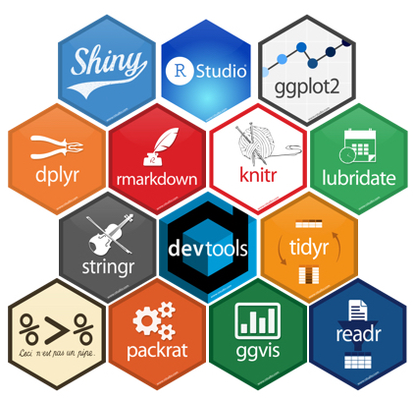
You need 4 things to run the code in this course:
1. R
2. RStudio
3. a collection of R packages called the tidyverse
4. a handful of other packages
Packages are the fundamental units of reproducible R code. They include reusable functions, documentation that describes how to use them, and sample data.

Slide 32

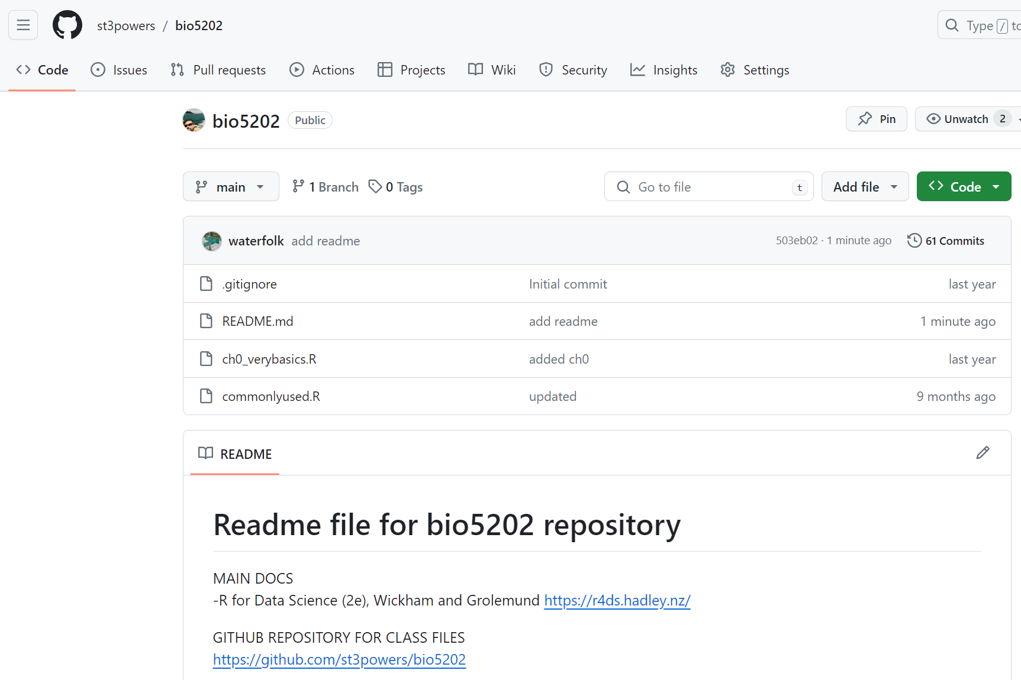
You will also need a Github account to access shared files and data

Slide 33
Workspace & History
Code Editor
Viewer
Console

Slide 34
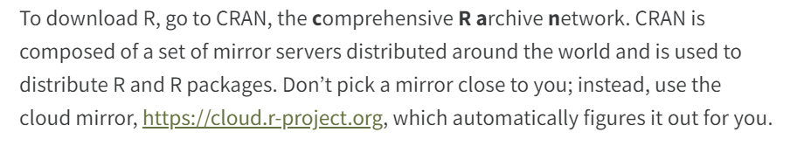
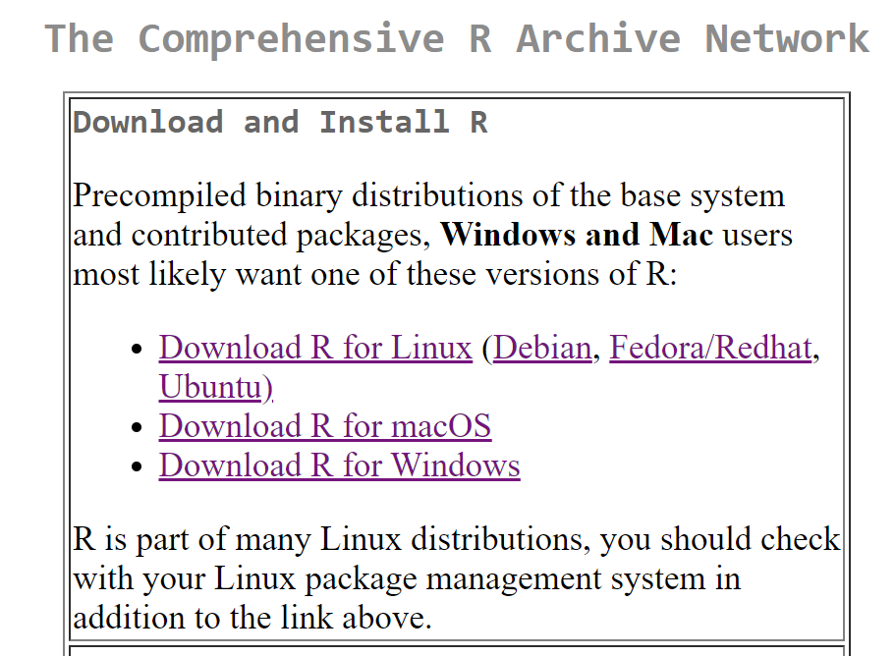

Slide 35
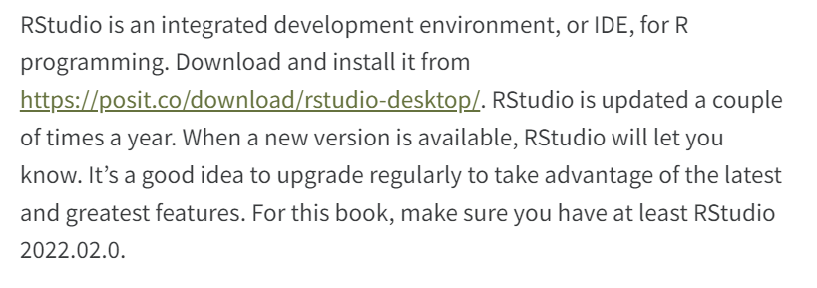

Slide 36
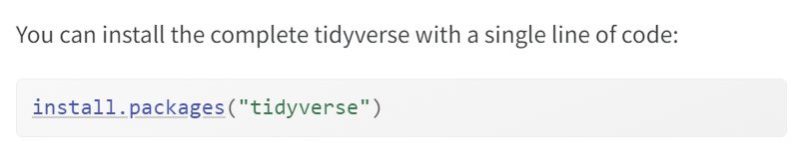

Slide 37
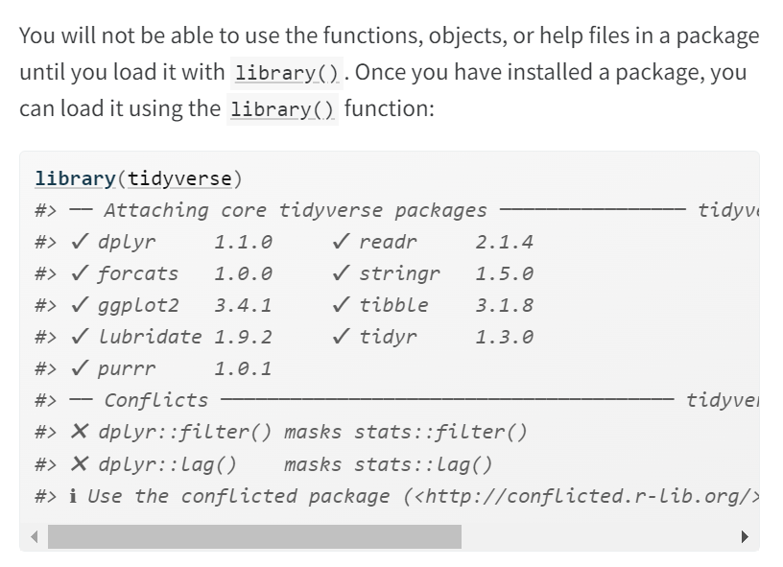

Slide 38
README.md TheVeryBasics.R

Slide 39
Read
1- Data visualization
2- Workflow: basics

Slide 40
Introduction discussion

Slide 42
Read
1- Data visualization
2- Workflow: basics

Slide 43
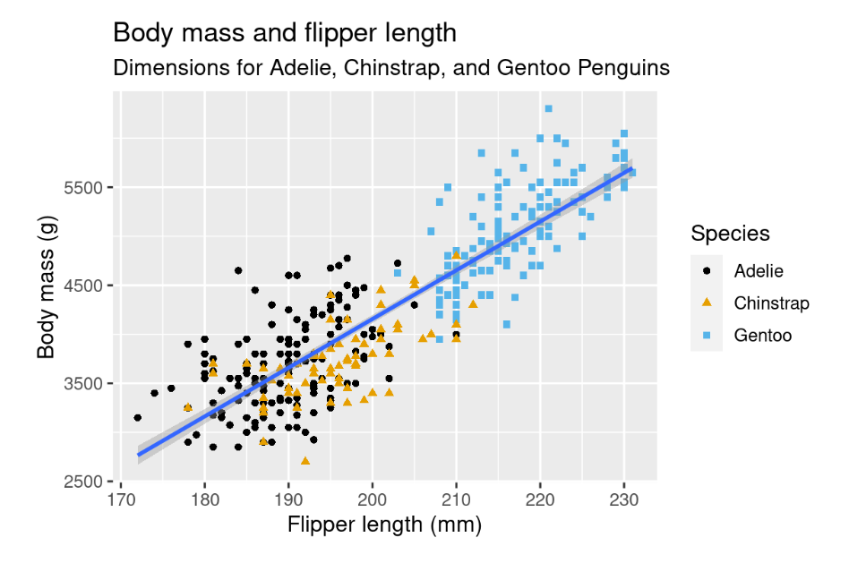
Make this plot
https://r4ds.hadley.nz/data-visualize.html

Slide 44
How many functions exist in base R?
How many functions exist in tidyverse?
How many packages exist on CRAN? (Comprehensive R Archive Network)

Slide 45
Files for you…
Readme
TheVeryBasics.R
CommonlyUsed.R
base r cheat sheet
oldschoolRedcard

Slide 46
From Ch 5 of Wilke, Directory of Visualizations

Slide 47
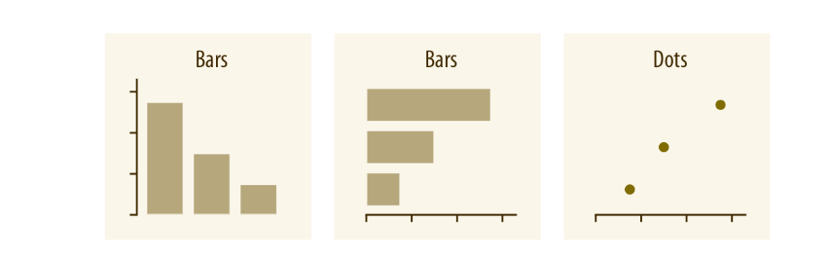
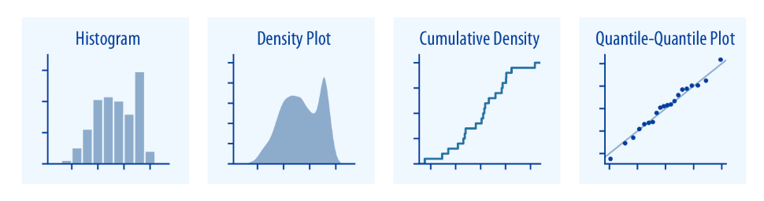
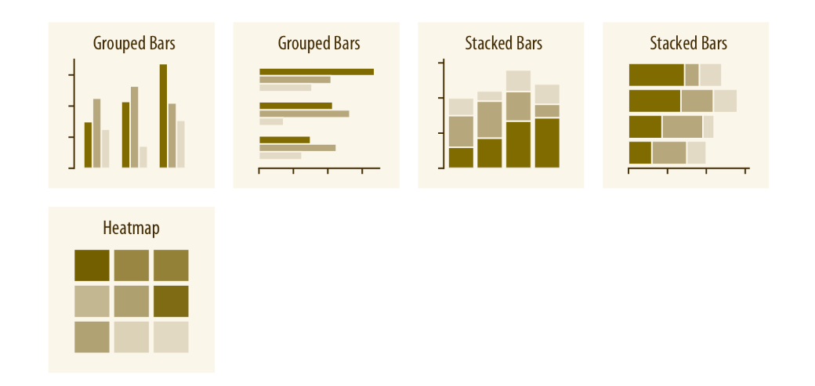
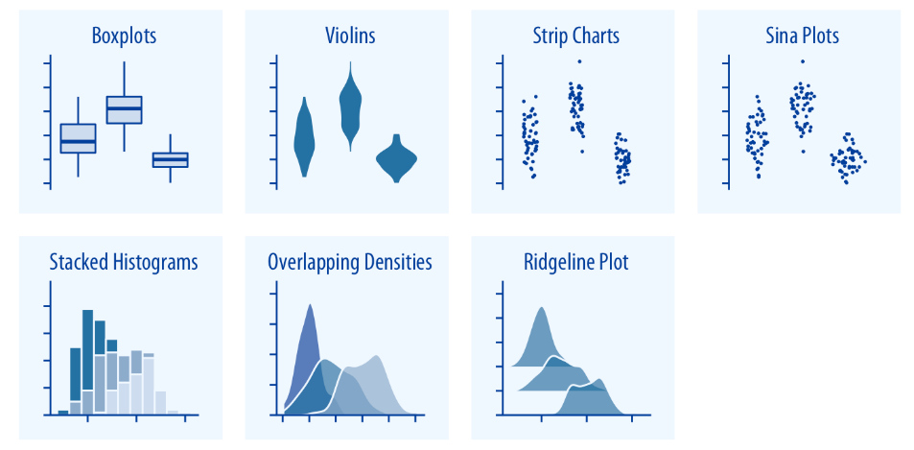
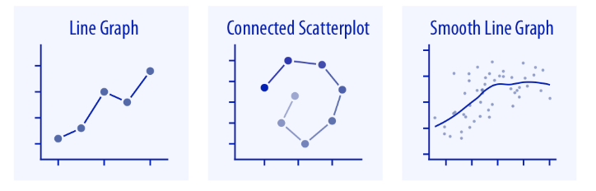
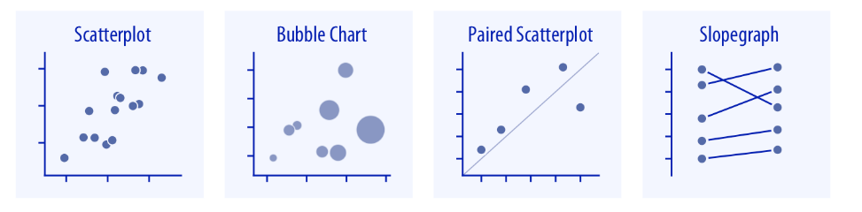
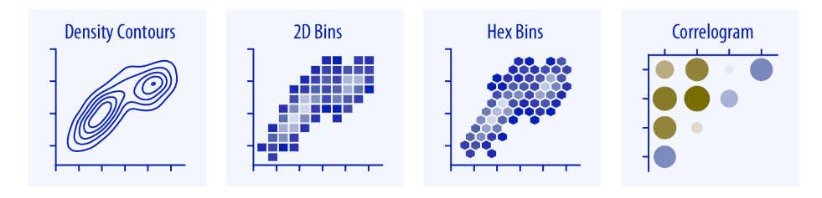
From Ch 5 of Wilke, Directory of Visualizations

